Slide 1
Data Structure
Stack, Queues and Recursion
Mohammad Gazi Golam Faruque
Associate Professor
Department of Computer Science and Engineering
KHWAJA YUNUS ALI UNIVERSITY

Slide 2
Related CLOs
Course Learning Outcome (CLO)
CLOs | After successful completing this course, students will be able to. | PLO Mapping
CLO1 | Understand the concept of data structures to apply the algorithm for solving problems. | PO1, PO2
CLO2 | Choose a suitable algorithm to organize the data in several structure in computer. | PO4, PO5
CLO3 | Implement the various data structure algorithm for solving real-life problems. | PO2, PO3
CLO4 | Develop the new sustainable data structure to solve the upcoming problems. | PO12
CLO5 | Explore the various operations of linear, non-linear and dynamic data structures. | PO3, PO12

Slide 3
Discuss Topics
Stacks
Queues
Recursion

Slide 4
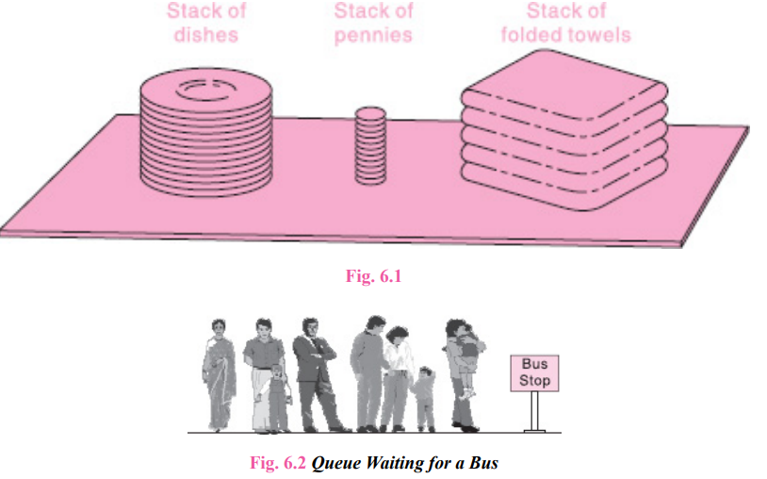
Stacks, Queues, Recursion

Slide 5
STACKS
A stack is a list of elements in which an element may be inserted or deleted only at one end, called the top of the stack. This means, in particular, that elements are removed from a stack in the reverse order of that in which they were inserted into the stack.
Special terminology is used for two basic operations associated with
stacks:
“Push” is the term used to insert an element into a stack.
“Pop” is the term used to delete an element from a stack.
We emphasize that these terms are used only with stacks, not with other data structures.

Slide 6
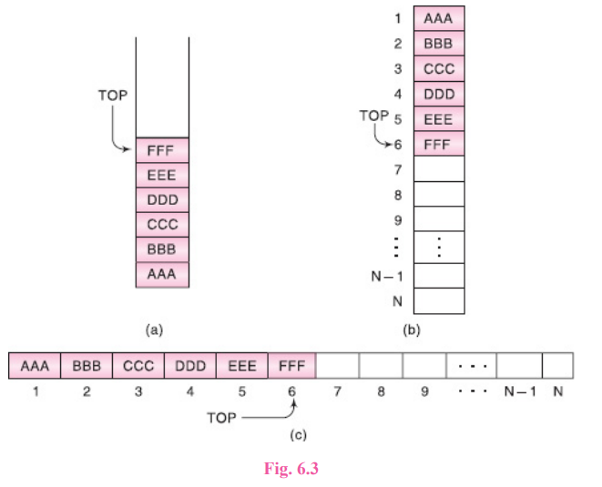
STACKS

Slide 7
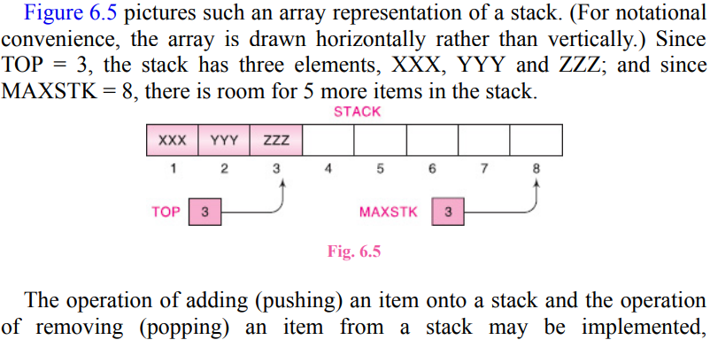
ARRAY REPRESENTATION OF STACKS

Slide 8
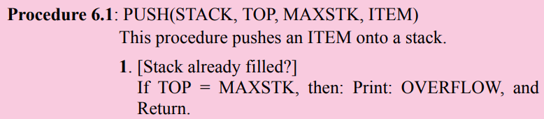
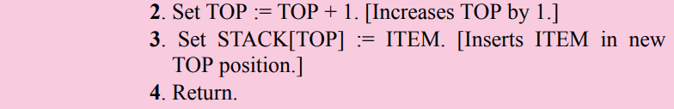
Stack Operations

Slide 9
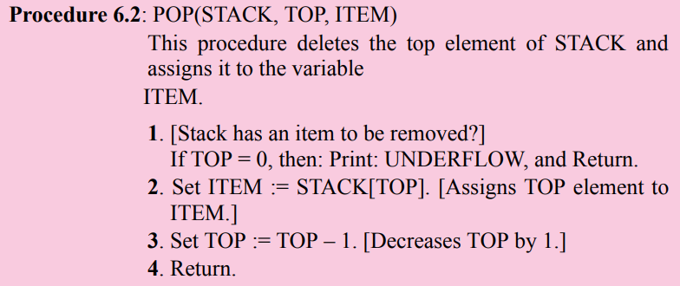
Stack Operations

Slide 10
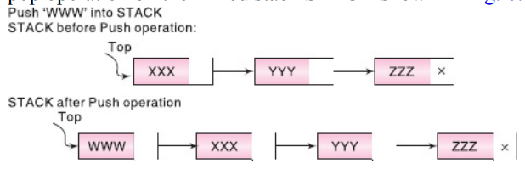
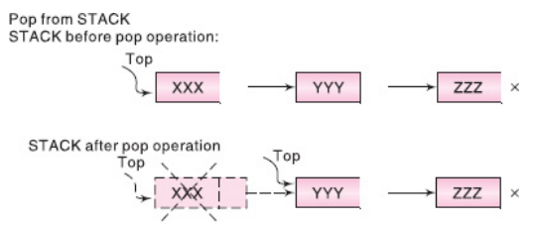
LINKED REPRESENTATION OF STACKS
The linked representation of a stack, commonly termed linked stack is a stack that is implemented using a singly linked list. The INFO fields of the nodes hold the elements of the stack and the LINK fields hold pointers to the neighbouring element in the stack. The START pointer of the linked list behaves as the TOP pointer variable of the stack and the null pointer of the last node in the list signals the bottom of stack. Figure 6.7 illustrates the linked representation of the stack STACK shown in Fig. 6.5.

Slide 12
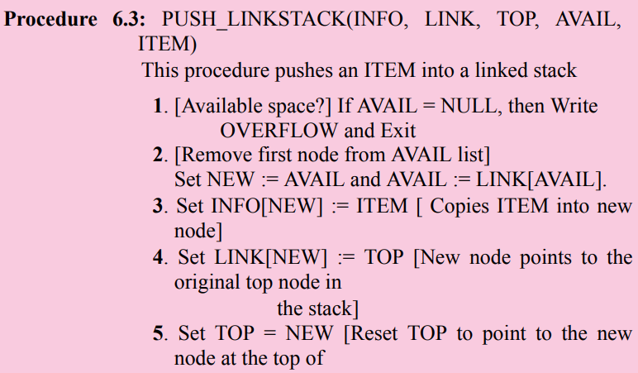

LINKED STACKS (PUSH)

Slide 13
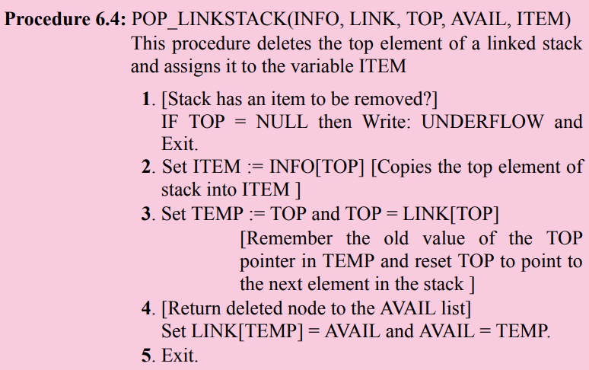
LINKED STACKS (POP)

Slide 14
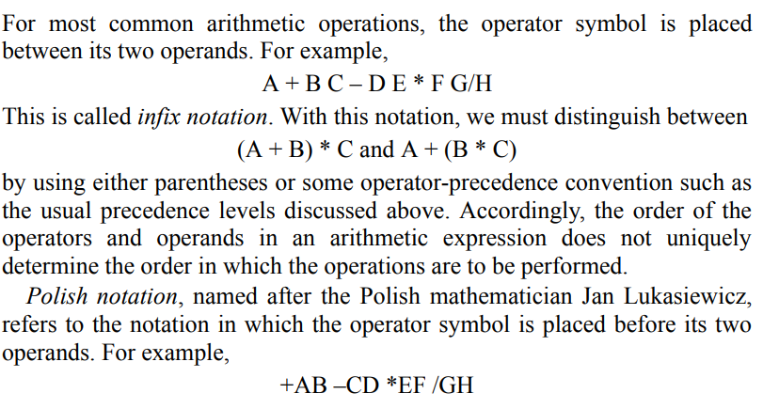
ARITHMETIC EXPRESSIONS: POLISH NOTATION
Polish Notation

Slide 16
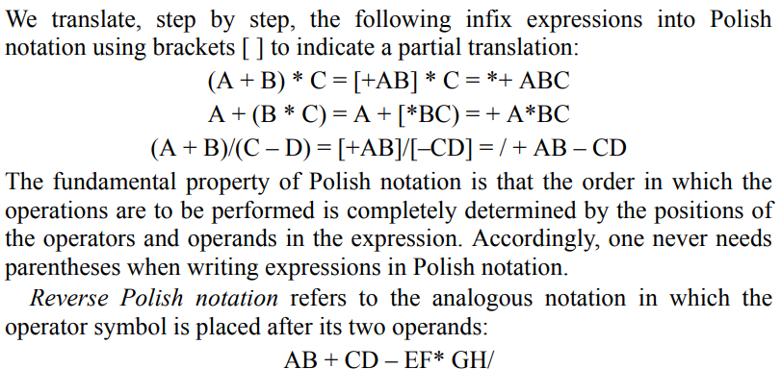
ARITHMETIC EXPRESSIONS: POLISH NOTATION

Slide 17
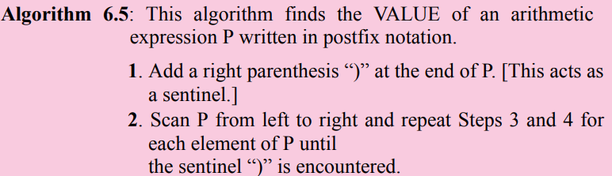
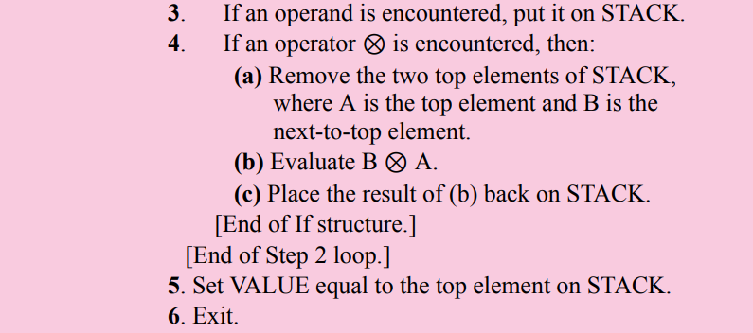
Evaluation of a Postfix Expression

Slide 18
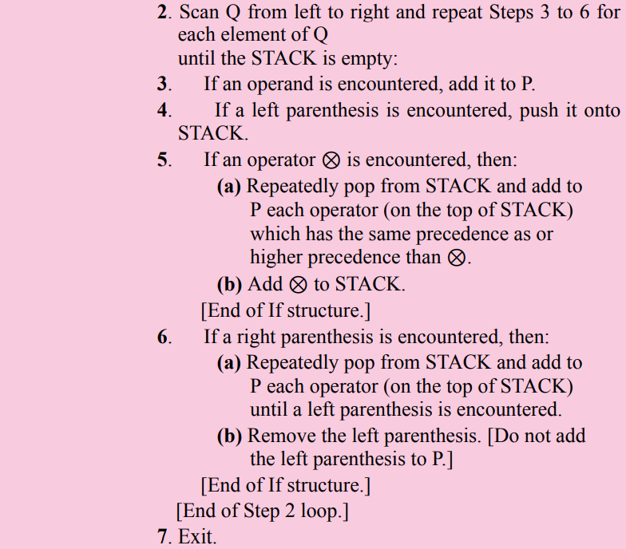
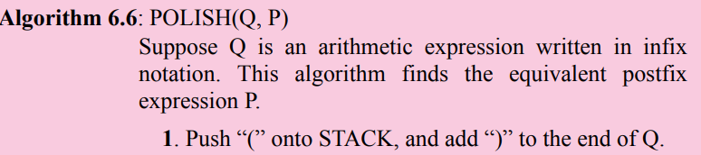
Transforming Infix Expressions into Postfix Expressions

Slide 19
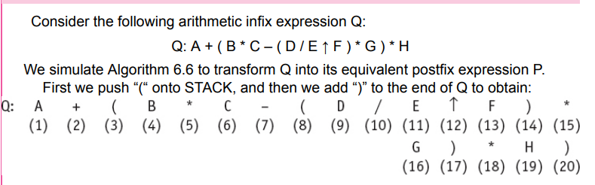
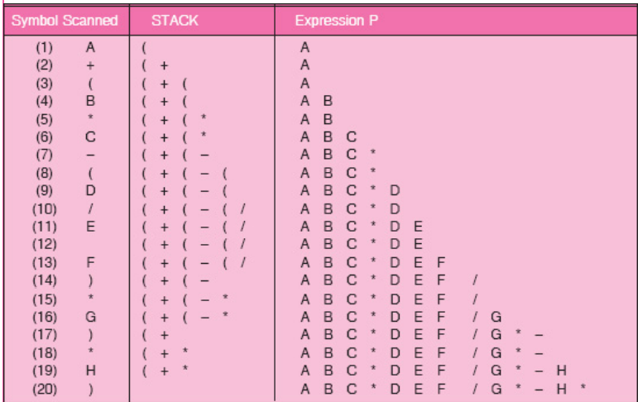

Slide 20
Example 6.7

Slide 21
QUICKSORT, AN APPLICATION OF STACKS

Slide 22
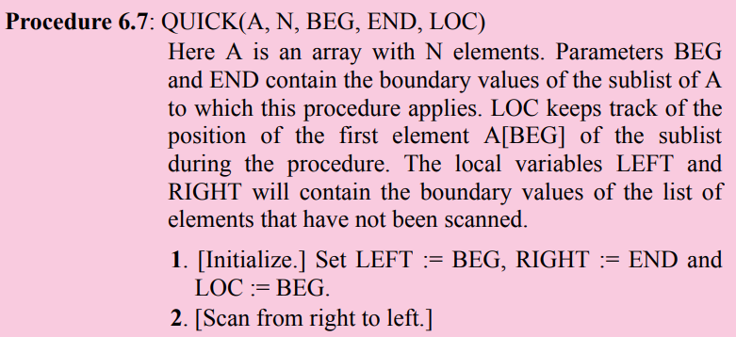
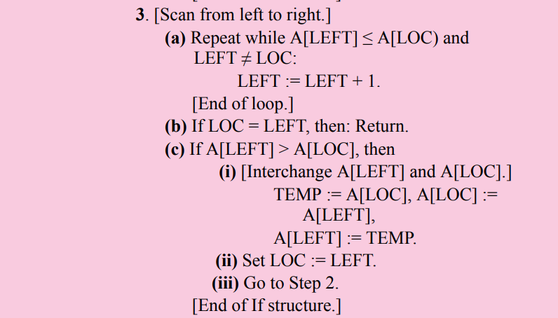
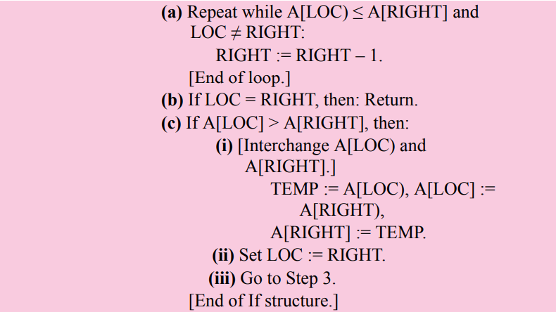

Slide 23
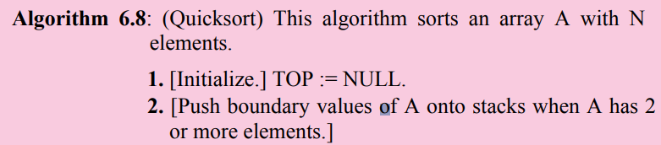
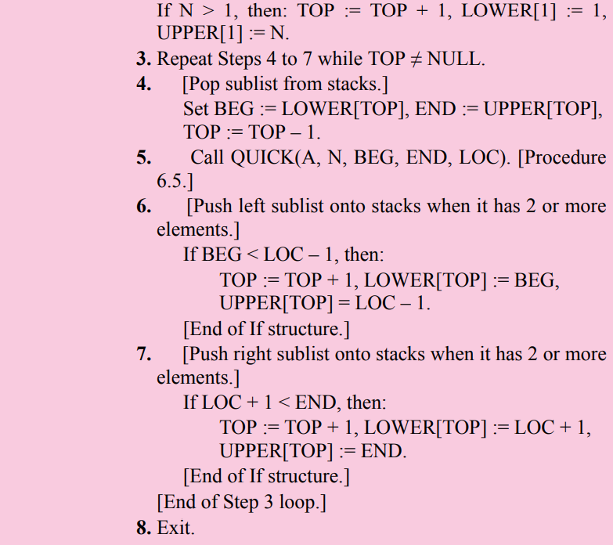

Slide 24
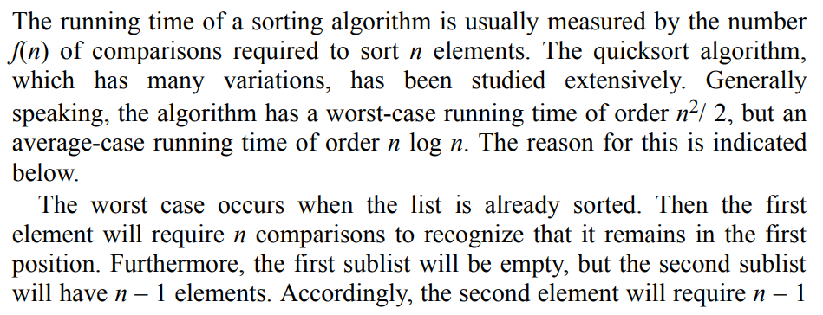
Complexity of the Quicksort Algorithm

Slide 25
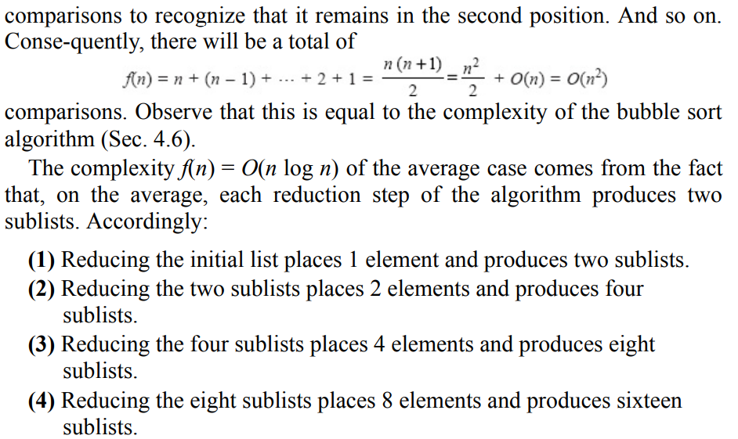

Slide 26
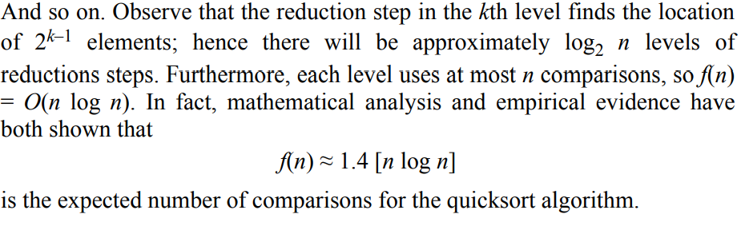
Complexity of the Quicksort Algorithm

Slide 27
RECURSION
Recursion is an important concept in computer science. Many algorithms can be best described in terms of recursion. This section introduces this powerful tool, and Sec. 6.9 will show how recursion may be implemented by means of stacks.
There must be certain criteria, called base criteria, for which the procedure does not call itself.
Each time the procedure does call itself (directly or indirectly), it must be closer to the base criteria.
A recursive procedure with these two properties is said to be well-defined.

Slide 28
RECURSION
Similarly, a function is said to be recursively defined if the function definition refers to itself. Again, in order for the definition not to be circular, it must have the following two properties:
There must be certain arguments, called base values, for which the function does not refer to itself.
Each time the function does refer to itself, the argument of the function must be closer to a base value
A recursive function with these two properties is also said to be well defined.

Slide 29
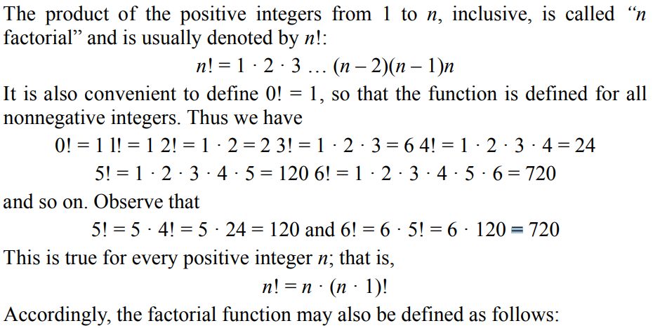
Factorial Function

Slide 30
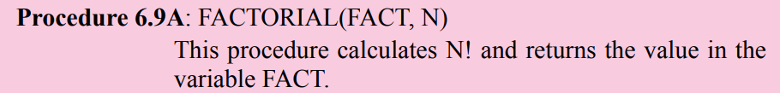
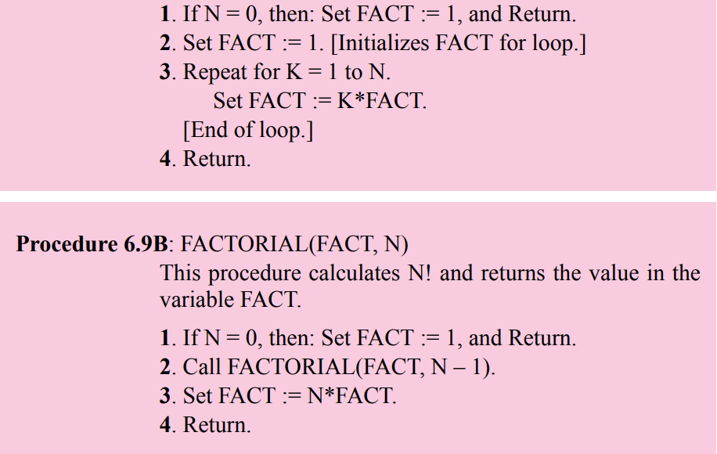

Slide 31
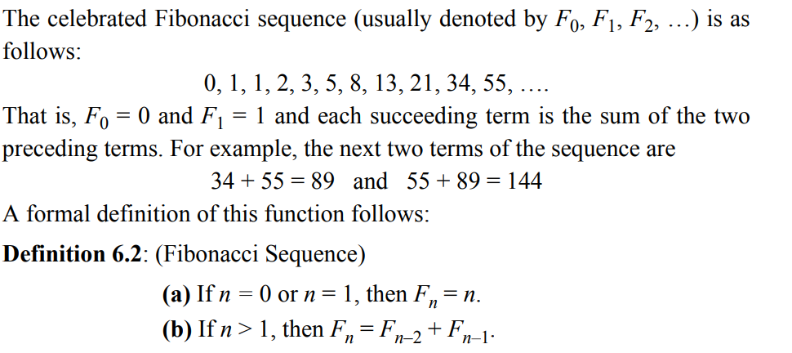
Fibonacci Sequence

Slide 32
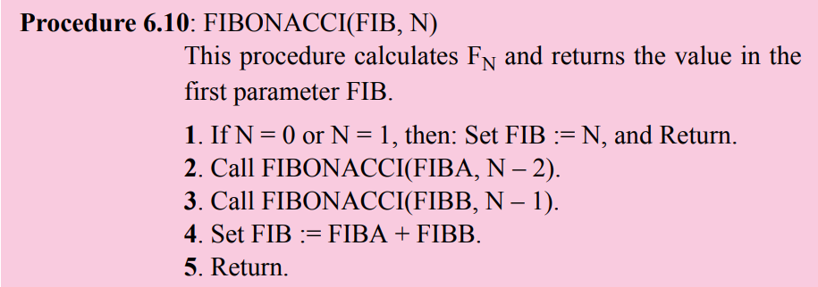
Fibonacci Sequence

Slide 33
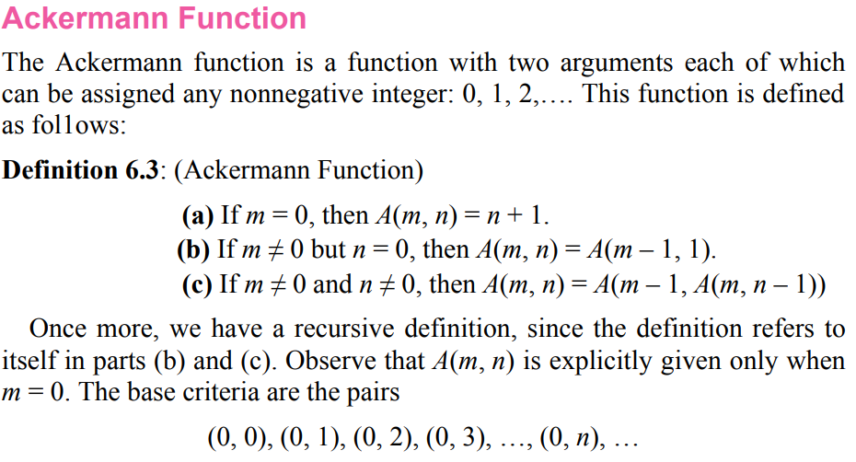
Divide-and-Conquer Algorithms

Slide 34
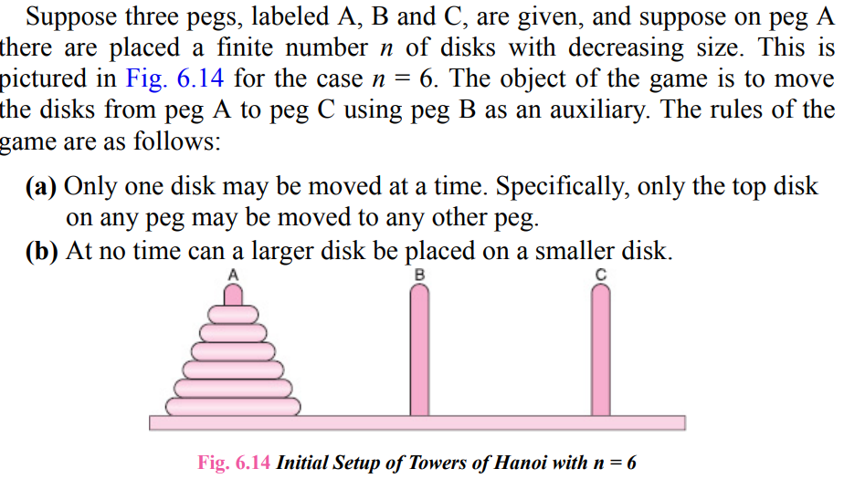
TOWERS OF HANOI

Slide 35
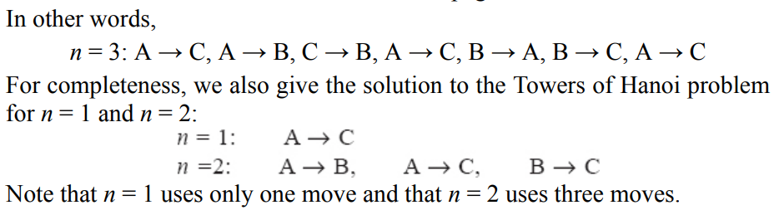
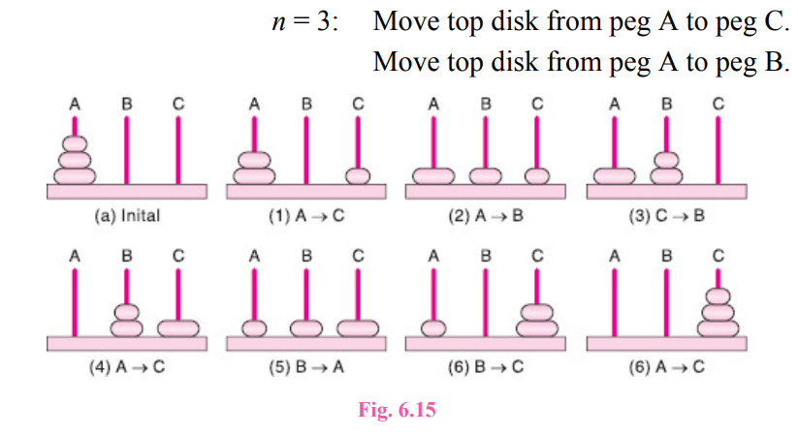
TOWERS OF HANOI

Slide 36
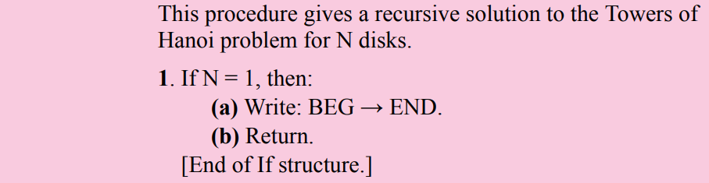
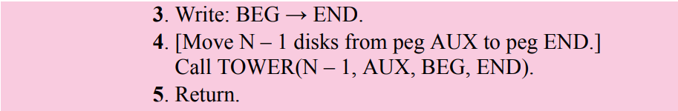
TOWERS OF HANOI (Algorithm)

Slide 37
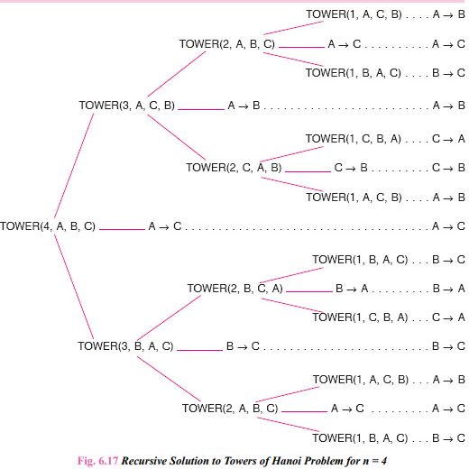

Slide 38
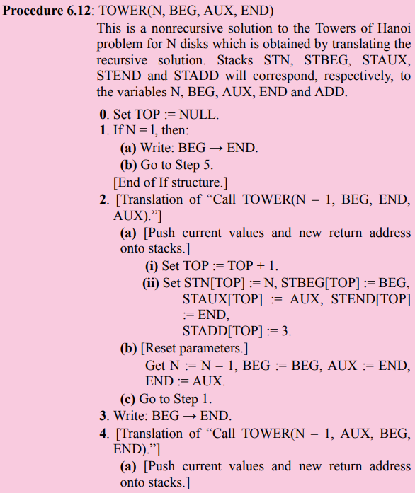
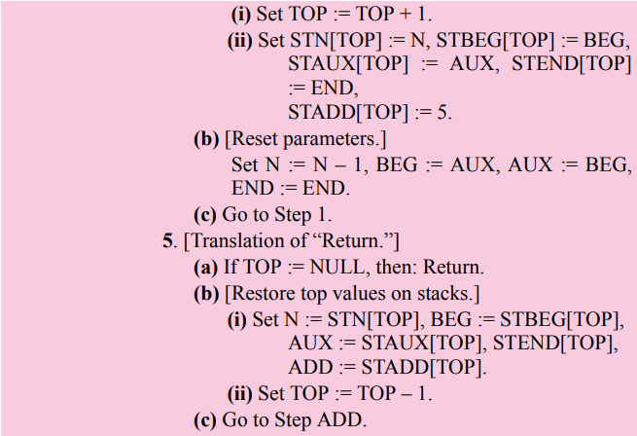
Towers of Hanoi: Revisited

Slide 39
QUEUES
A queue is a linear list of elements in which deletions can take place only at one end, called the front, and insertions can take place only at the other end, called the rear. The terms “front” and “rear” are used in describing a linear list only when it is implemented as a queue.
Queues are also called first-in first-out (FIFO) lists, since the first element in a queue will be the first element out of the queue. In other words, the order in which elements enter a queue is the order in which they leave. This contrasts with stacks, which are last-in first-out (LIFO) lists.

Slide 40
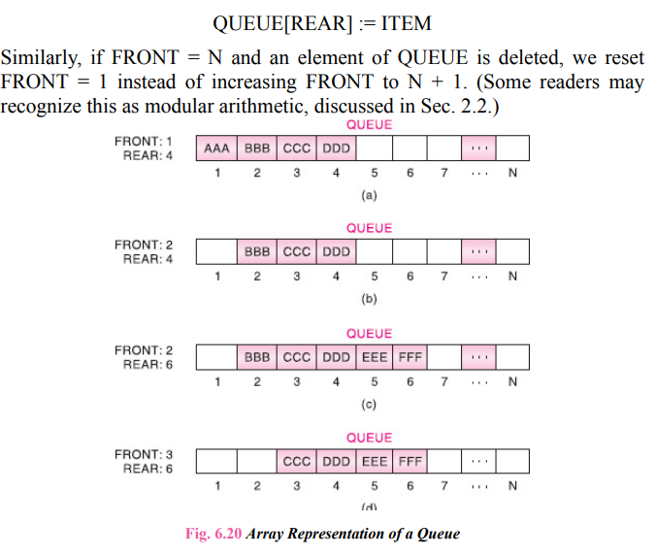
Representation of Queues

Slide 41
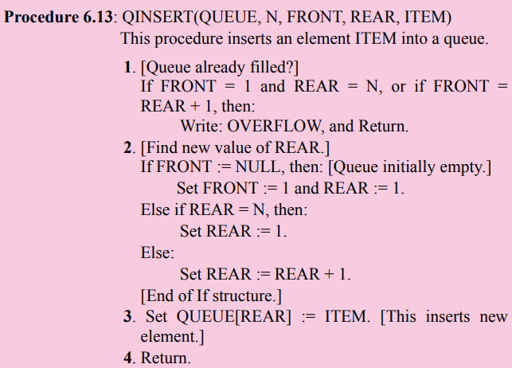
Queue Insert

Slide 42
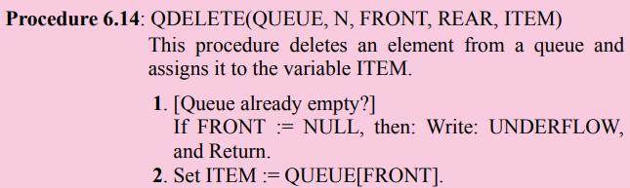
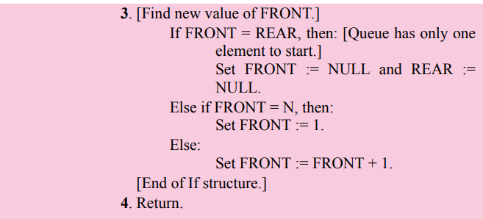
Queue Delete

Slide 43
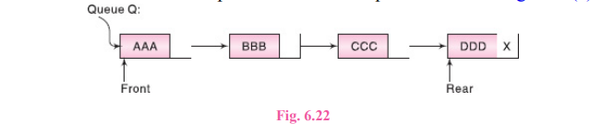
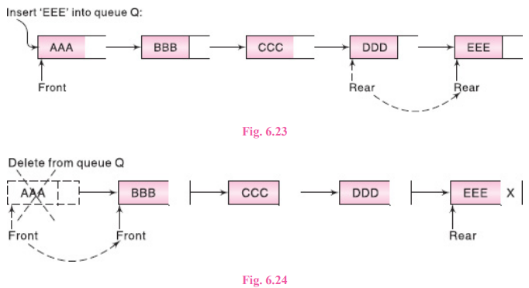
LINKED REPRESENTATION OF QUEUES

Slide 44
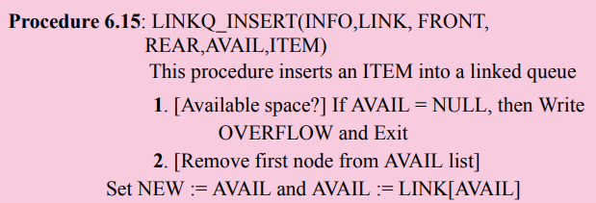
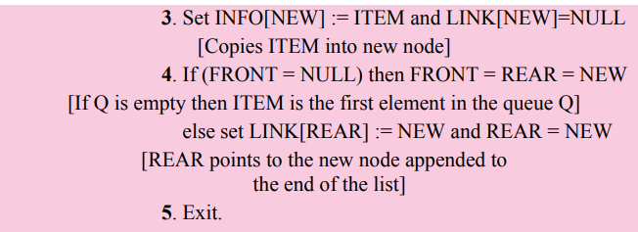

Slide 45
LINKQ_DELETE (INFO, LINK, FRONT, REAR, AVAIL, ITEM)
Procedure 6.16: LINKQ_DELETE (INFO, LINK, FRONT, REAR, AVAIL, ITEM)
This procedure deletes the front element of the linked queue and stores it in ITEM
1. [Linked queue empty?] if (FRONT = NULL) then Write: UNDERFLOW and Exit
2. Set TEMP = FRONT [If linked queue is nonempty, remember FRONT in a temporary variable TEMP]
3. ITEM = INFO (TEMP)
4. FRONT = LINK (TEMP) [Reset FRONT to point to the next element in the queue]
5. LINK(TEMP) =AVAIL and AVAIL=TEMP [return the deleted node TEMP to the AVAIL list]
6. Exit.

Slide 46
DEQUES
A deque (pronounced either “deck” or “dequeue”) is a linear list in which elements can be added or removed at either end but not in the middle. The term deque is a contraction of the name double-ended queue.
There are various ways of representing a deque in a computer. Unless it is otherwise stated or implied, we will assume our deque is maintained by a circular array DEQUE with pointers LEFT and RIGHT, which point to the two ends of the deque. We assume that the elements extend from the left end to the right end in the array. The term “circular” comes from the fact that we assume that DEQUE[1] comes after DEQUE[N] in the array. Figure 6.26 pictures two deques, each with 4 elements maintained in an array with N = 8 memory locations. The condition LEFT = NULL will be used to indicate that a deque is empty.

Slide 47
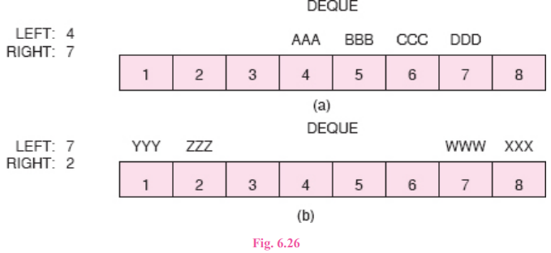
DEQUES
There are two variations of a deque—namely, an input-restricted deque and an output-restricted deque—which are intermediate between a deque and a queue. Specifically, an input-restricted deque is a deque which allows insertions at only one end of the list but allows deletions at both ends of the list; and an output-restricted deque is a deque which allows deletions at only one end of the list but allows insertions at both ends of the list.

Slide 48
PRIORITY QUEUES
A priority queue is a collection of elements such that each element has been assigned a priority and such that the order in which elements are deleted and processed comes from the following rules:
An element of higher priority is processed before any element of lower priority.
Two elements with the same priority are processed according to the order in which they were added to the queue.
A prototype of a priority queue is a timesharing system: programs of high priority are processed first, and programs with the same priority form a standard queue.

Slide 49
One-Way List Representation of a Priority Queue
One way to maintain a priority queue in memory is by means of a one-way list, as follows:
Each node in the list will contain three items of information: an information field INFO, a priority number PRN and a link number LINK.
A node X precedes a node Y in the list (1) when X has higher priority than Y or (2) when both have the same priority but X was added to the list before Y. This means that the order in the one-way list corresponds to the order of the priority queue.
Priority numbers will operate in the usual way: the lower the priority number, the higher the priority.

Slide 50
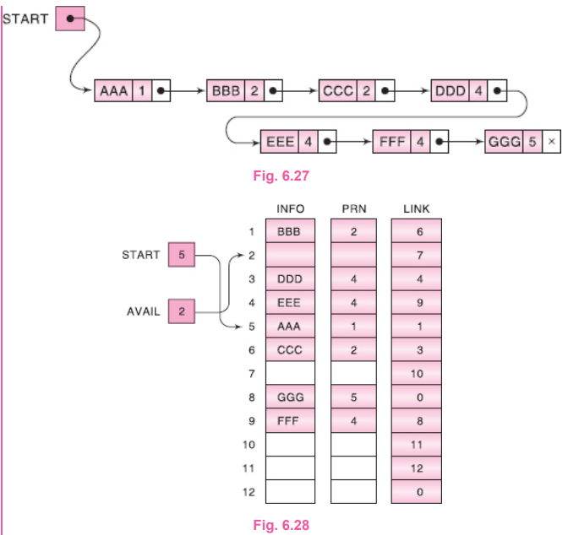

One-Way List Representation of a Priority Queue

Slide 51


One-Way List Representation of a Priority Queue

Slide 52

Array Representation of a Priority Queue

Slide 53

Array Representation of a Priority Queue

Slide 54
Important Sample Questions
All exercise from Solved Problems.
All exercise from Supplementary Problems
All exercise from Programming Problems

Slide 55
Next Week Topics
Trees

Slide 56
Thank You

